Slide 1
Cisco Meraki Virtual MX

Slide 2
Agenda:
vMX License
Meraki Dashboard Configuration

Slide 3
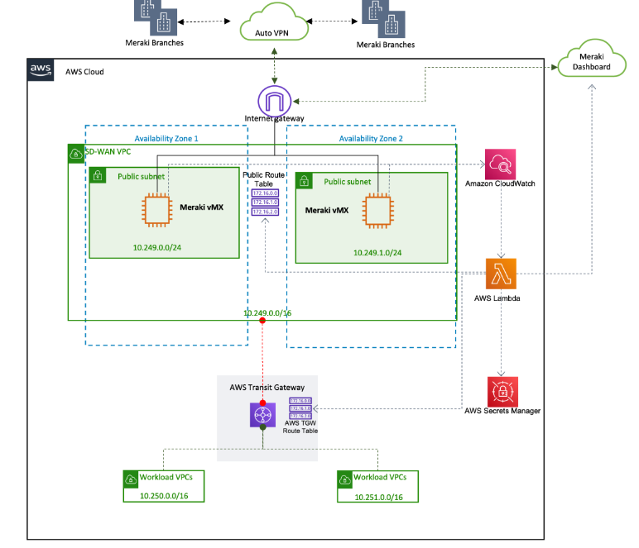
Architecture

Slide 4
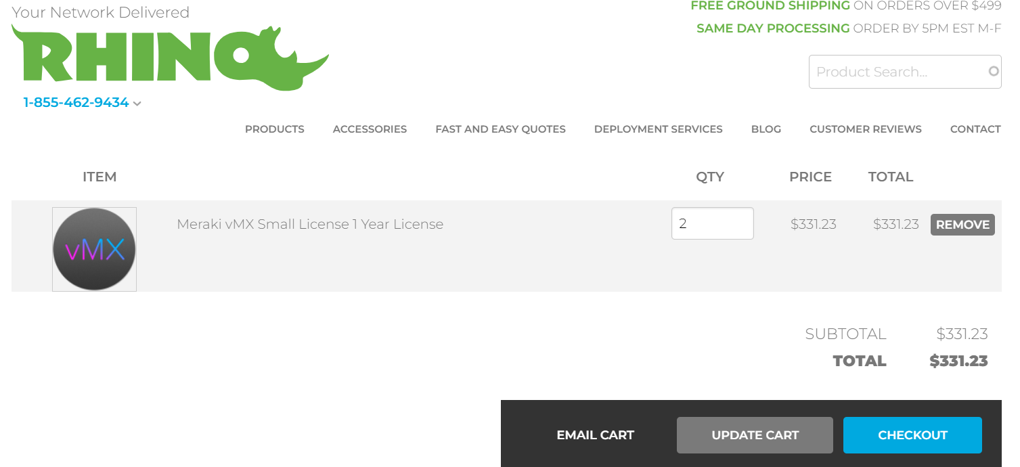
vMX License
Add license(s) to the Meraki dashboard
To complete the vMX Meraki dashboard configuration, a vMX license must be available for use in our organization.
We can buy license at:
Search Products - Rhino Networks

Slide 5
Meraki Subscription Licensing - Subscription Claim - Cisco Meraki Documentation

Slide 6
Meraki Dashboard Configuration
Complete the instructions in the "Meraki Dashboard Configuration" section of vMX Setup Guide for Amazon Web Services (AWS). During configuration, you generate authentication tokens for the vMX appliances. Copy and save the tokens. You must enter them in the vMX1Token and vMX2Token parameters in the AWS CloudFormation console during Quick Start deployment.

Slide 7
Note:
2 licenses are required for 2 instances which will be created in 2 availability zones which ensures high availability & reliability
Add users to the Cisco Meraki Dashboard. We need this to add license in organization and generate authentication token which will be used to deploy instance.
Before generating the token, please verify the firmware is configured for MX 15.37+. If the vMX network firmware is set to anything below that, the upgrade will not occur.
The authentication token must be entered into the AWS Cloud instance within one hour of generating it, otherwise a new token must be generated.

